Slide 1
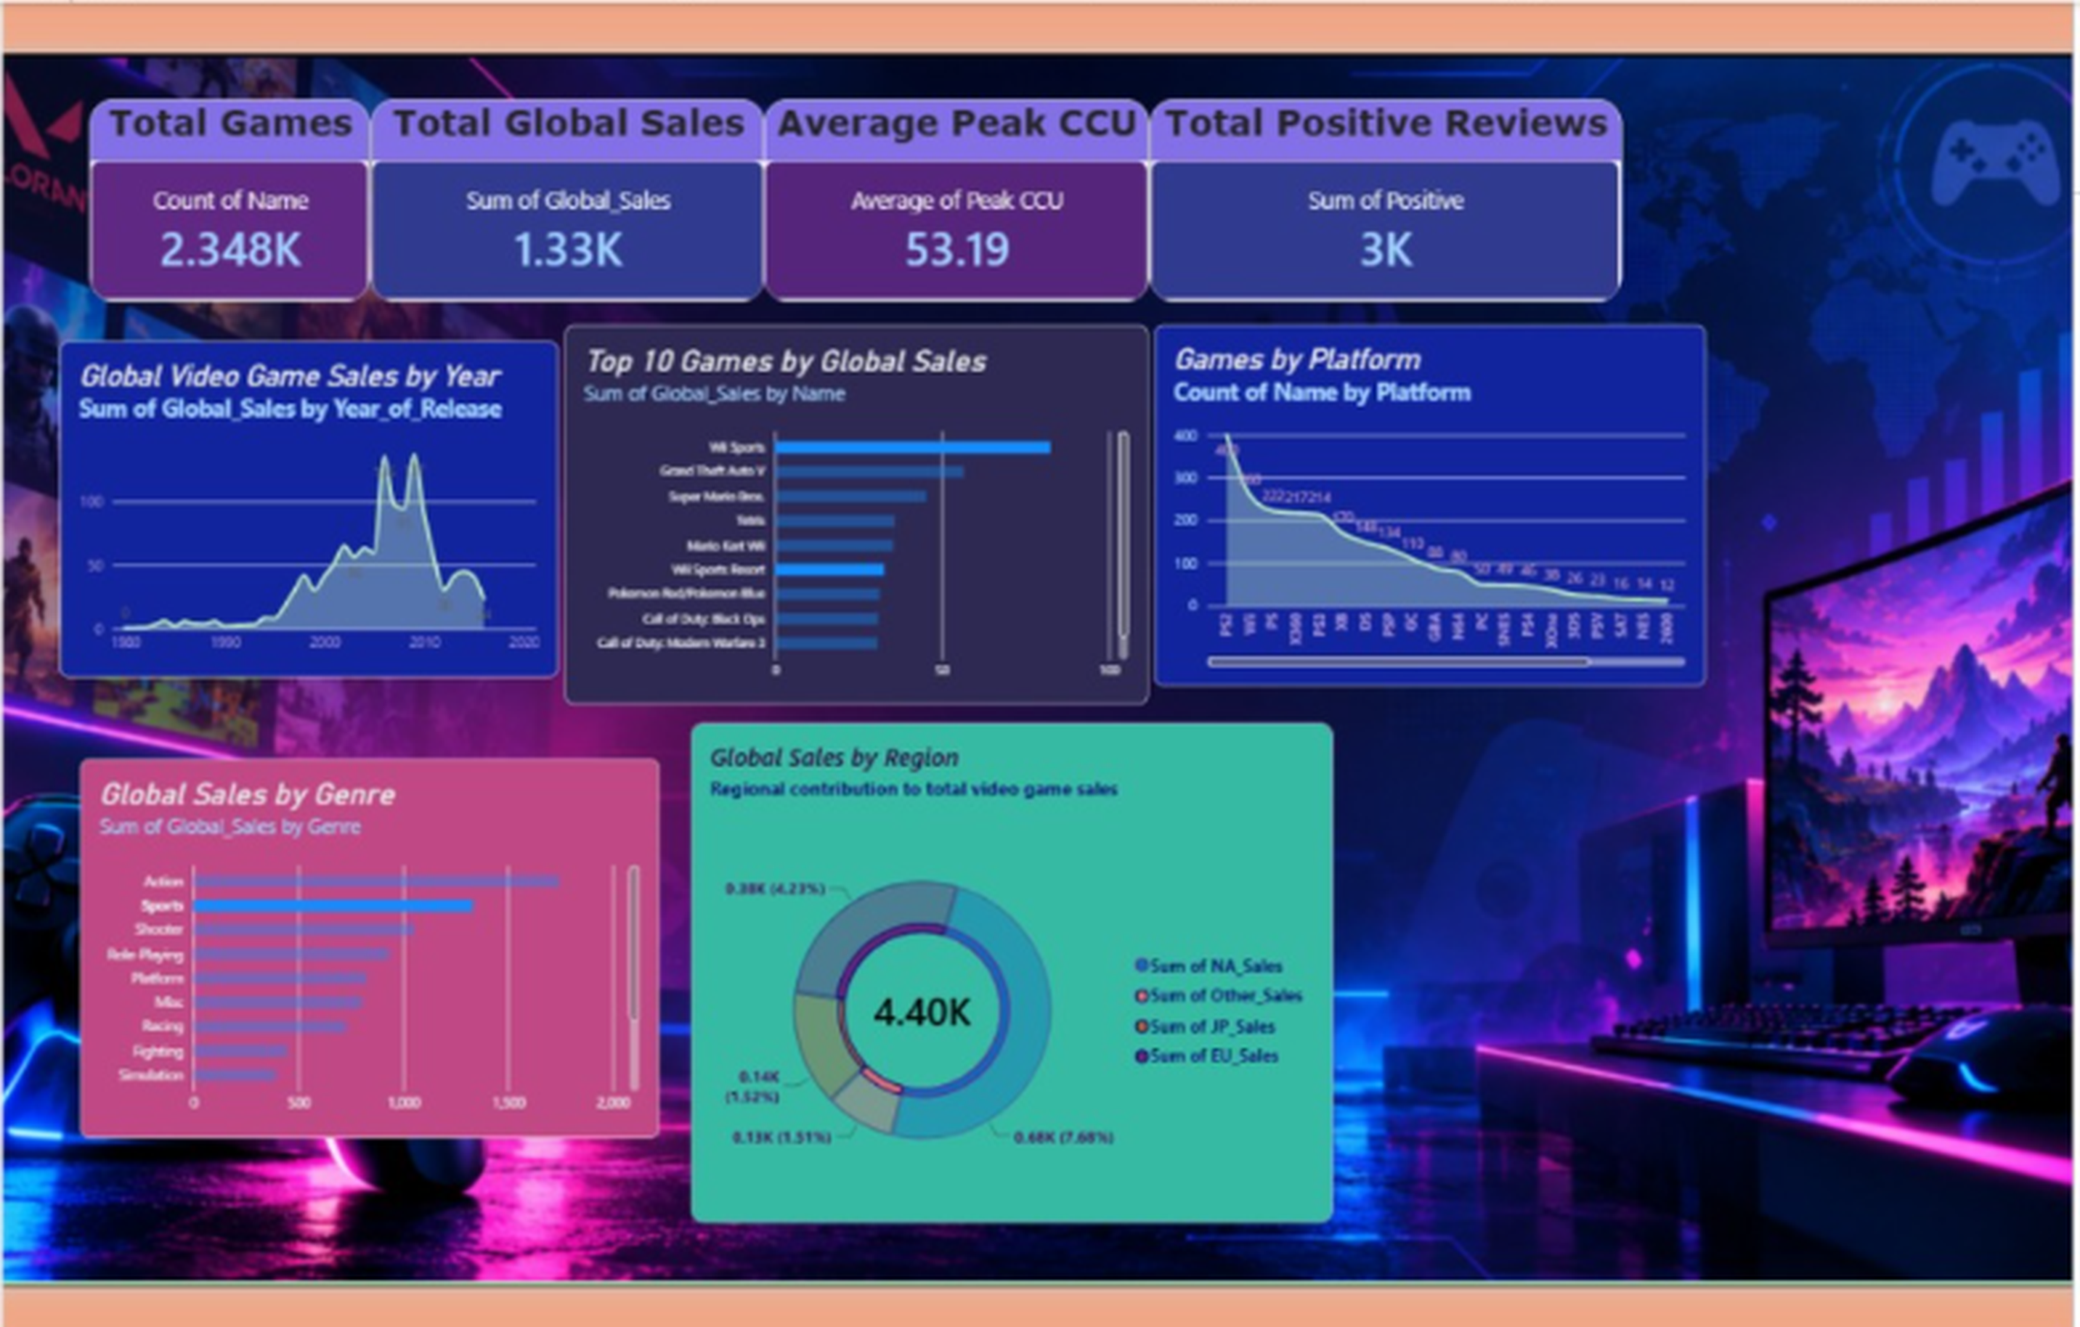
GLOBAL VIDEO GAME
Sales Dashboard Analysis
What 2,348 games, five charts and four KPIs tell us about the market
Notes:
Introduce the dashboard and what the presentation will cover.

Slide 2
The dashboard at a glance
2.348K
1.33K
53.19
3K
Total games
Total global sales
Average peak CCU
Total positive reviews
Five charts then break the numbers down by:
Year
Game
Platform
Genre
Region
Notes:
Total games 2.348K, total global sales 1.33K, average peak CCU 53.19, total positive reviews 3K.

Slide 3
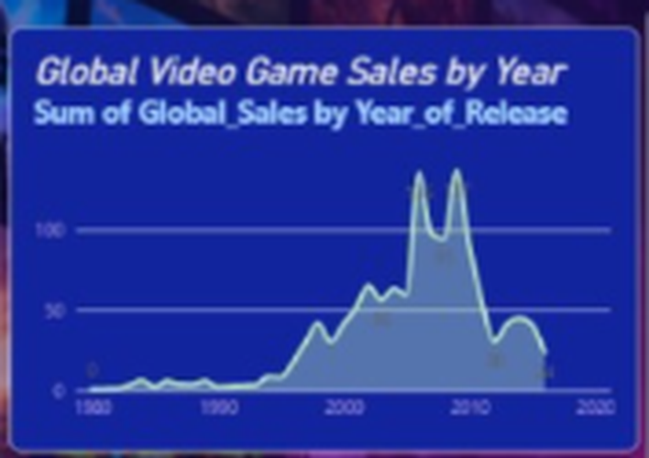
Sales peaked in the late 2000s
WHAT IT SHOWS
Very low sales until the mid-1990s
Two peaks: around 2005-06 and 2008-09
Steady decline after 2010
Insight
The latest years may be incomplete, so read the drop with care.
Notes:
Sales peaked in the late 2000s. Very low sales until the mid-1990s Two peaks: around 2005-06 and 2008-09 Steady decline after 2010 Insight: The latest years may be incomplete, so read the drop with care.

Slide 4
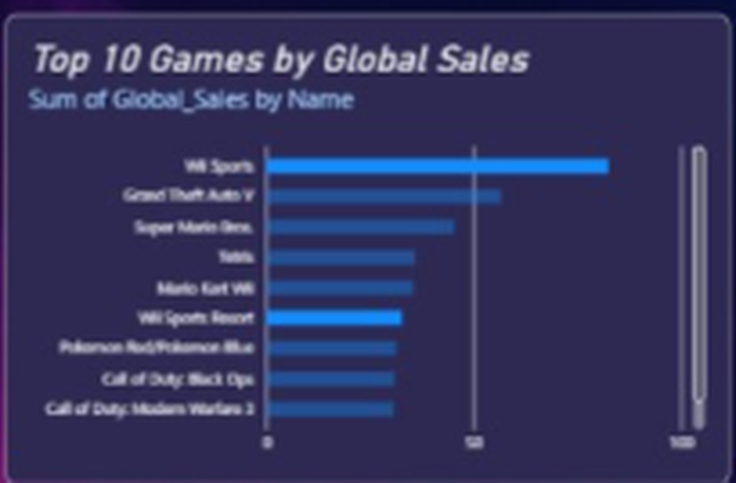
Wii Sports towers over the rest
WHAT IT SHOWS
Wii Sports leads by a wide margin
GTA V, Super Mario Bros. and Tetris follow
Nintendo titles dominate the top ten
Insight
A few blockbuster franchises drive a large share of sales.
Notes:
Wii Sports towers over the rest. Wii Sports leads by a wide margin GTA V, Super Mario Bros. and Tetris follow Nintendo titles dominate the top ten Insight: A few blockbuster franchises drive a large share of sales.

Slide 5
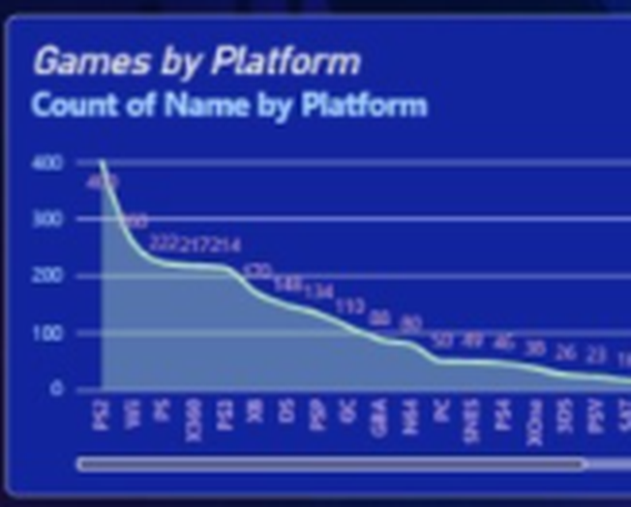
A few platforms hold most games
WHAT IT SHOWS
The largest platform has about 400 games
Next platforms fall to roughly 220
A long tail has fewer than 100 each
Insight
The catalogue is concentrated on a handful of popular platforms.
Notes:
A few platforms hold most games. The largest platform has about 400 games Next platforms fall to roughly 220 A long tail has fewer than 100 each Insight: The catalogue is concentrated on a handful of popular platforms.

Slide 6
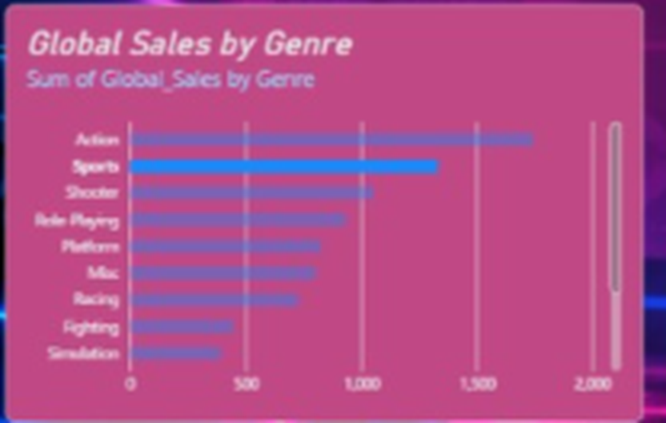
Action and Sports lead the genres
WHAT IT SHOWS
Action is first at about 1,700+
Sports is second at about 1,300
Fighting and Simulation are lowest, near 400
Insight
Action, Sports and Shooter are the safest bets for new releases.
Notes:
Action and Sports lead the genres. Action is first at about 1,700+ Sports is second at about 1,300 Fighting and Simulation are lowest, near 400 Insight: Action, Sports and Shooter are the safest bets for new releases.

Slide 7
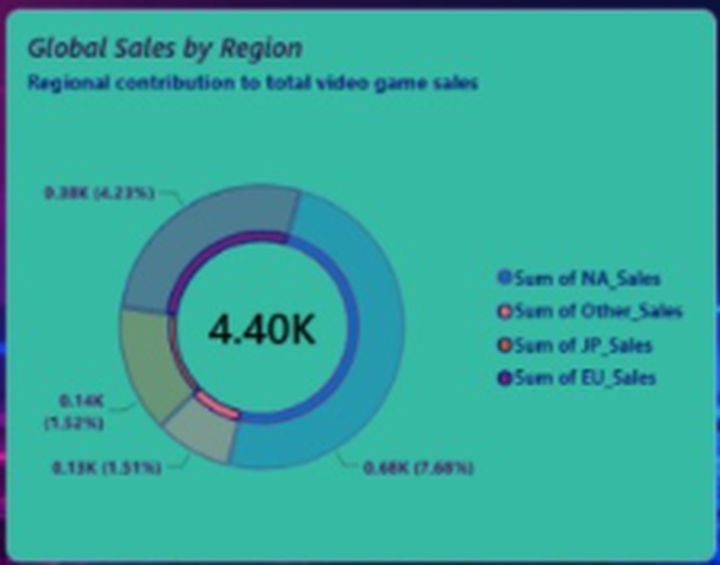
Sales are uneven across regions
WHAT IT SHOWS
Combined total shown: 4.40K
Largest slice is labelled 0.68K
Other slices: 0.38K, 0.14K and 0.13K
Insight
Focus marketing on the strongest regions and test growth in the rest.
Notes:
Sales are uneven across regions. Combined total shown: 4.40K Largest slice is labelled 0.68K Other slices: 0.38K, 0.14K and 0.13K Insight: Focus marketing on the strongest regions and test growth in the rest.

Slide 8
Key takeaways
Boom, then decline
Sales grew from the mid-1990s, peaked in the late 2000s, then fell.
Hit-driven market
A handful of titles, led by Wii Sports, drive much of the sales.
1
2
Genre focus
Action, Sports and Shooter are the strongest genres.
Concentrated reach
Few platforms and regions account for most games and sales.
3
4

Slide 9
Before sharing: check the data
Totals do not match
KPI shows 1.33K sales but the donut centre shows 4.40K.
NEXT STEPS
Fix the sales measures so totals agree
Add year, genre and platform slicers
Add units (millions) to every chart
Region percentages
Slice labels such as 0.68K (7.68%) do not form a 100% split.
Mixed data sources
Peak CCU and reviews may come from a different table than sales.

